Slide 1
Scanning the Landscape: Media Coverage of the Env't
PPI Seminar Workshop on Environmental Reporting

Slide 2
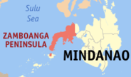
My work environment

Slide 3
Major observations about environmental reporting practice in the local/regional media
(Centrality of local context for nuanced appreciation of macro trends)
event-focused (destruction, protests)
lack of contextualizing
need to have more depth; identifying gaps and pointing out policy, regulatory implications

Slide 4
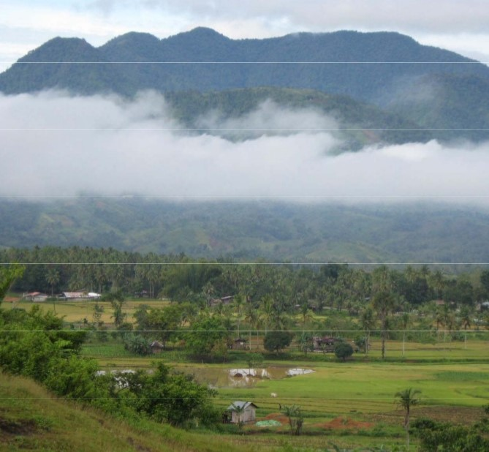
Exploring Relationships: (Ridge-to-reef frame)
Upstream
Midstream
Downstream

Slide 5
Exploring Relationships: (Ridge-to-reef frame)
DEFORESTATION
URBAN FLOODING

Slide 6
The case of mining
confined to the question of whether “to extract or not to extract”
but the issue is not that simple
The case of Sarangani
The case of Zamboanga Sibugay
The case of Bayog in Zamboanga del Sur

Slide 7
Taking abreast of in-depth trends
Communities
NGOs/advocates
Govt agencies and bodies
Academic institutions
Personal study

